Slide 1


Ungrouped Data
MATH 30-6
Probability and Statistics

Slide 2
OBJECTIVES
The students at the end of the lesson are expected to:
Define and Differentiate various measures of describing data
Describe a given set of data using various measures
Interpret values that arises from computation

Slide 3
Measures of Describing Data
Measure of Central Tendency
  Also known as Measure of Center, Measure of Central Location
  Measure of finding the mean, median or mode of the data set
Measure of Position
  Measure of finding the k^{th} element of the distribution. Also the quantiles or fractiles of distribution
Measure of Variation
  Measure of how the data is distributed abouth the mean.
Measure of Shape
  Measure of the degree of symmetry of a distribution

Slide 4
Measure of Central Location
Mean
  A parameter used to locate the average value or that would have the same effect as all of the data
Median
  The middle element of the distribution
Mode
  The most frequent data in the distribution

Slide 5
Mean
Most widely used parameter of describing a ratio data.
May be classified as
  Arithmentic Mean
  Geometric Mean
  Harmonic Mean
  Trimmed Mean
  Quadratic or Root Mean Square

Slide 6
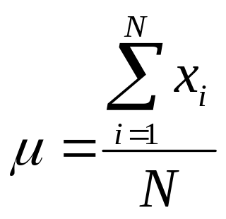
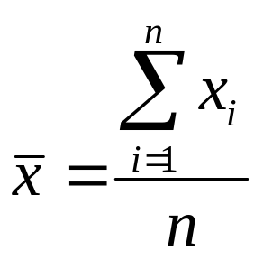
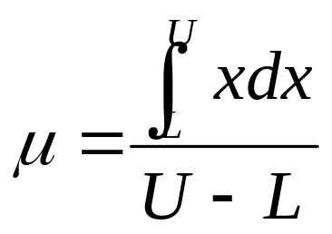
Arithmetic Mean
The arithmetic Average of the distribution
Population Mean Sample Mean
for discrete data.
for continuous case

Slide 7
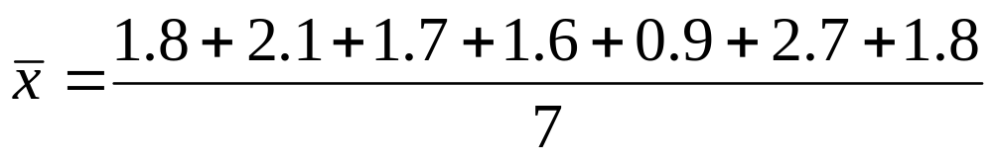

Arithmetic Mean
A food inspector examined a random sample of 7 cans of certain brand of peanut butter to determine the amount of foreign substance in mL. The following data were recorded: 1.8, 2.1, 1.7, 1.6, 0.9, 2.7, and 1.8. Compute the sample mean.
= 1.8 mL

Slide 8
Arithmetic Mean
If a total grade of 70% must be acquired by a student in Statistics, based on the average of the 3 quizzes, what should be Mary’s score on the third quiz if she got 60 and 85 in the first two quizzes?
Determine the average consumption of household of a newly installed meter where the first 10 meter readings were found as follows:
38 56 70 84 100 115 128 142 160

Slide 9
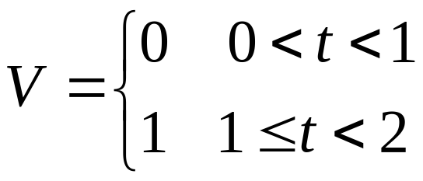
Arithmetic Mean
Determine the Average voltage of a signal that follows the following waveforms:
V = 10 sin t 0 < t < pi
V = t 0 < t <1

Slide 10
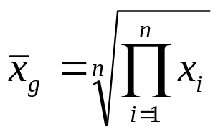
Geometric Mean
The geometric mean is used in factors being multiplied to another quantity. Examples of which are interest and discount rates, amplification factors being used. The formula for geometric mean is given by:
What is the geometric mean between the numbers 5, 9, 25, and 80?

Slide 11
Geometric Mean
Php 5000 is invested at a bank that offers different interest rates for five years. If the interest rates are 5% on the first year, 6%, 8%, 10% and 12% for the 2nd, 3rd, 4th and 5th year respectively. Find the average interest the bank offers for 5 years?
A four-stage amplifier with gains equal to 10, 30 , 50, 80 is to be replaced by a 4-stage identical amplifiers. What is the gain of each stage of the new configuration?
A cascaded system requires a two stage current gains of 50 and 90. What is the current gain of each of the transistors connected in Darlington pair (two identical BJT transistors connected in series) that could replace the configuration?

Slide 12
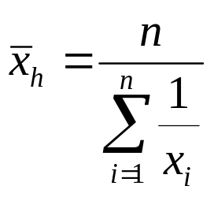
Harmonic Mean
The harmonic mean is used for the average of the time rates or averages of velocity, speed and alike. The formula for harmonic mean is given by:
If Dan’s speed in travelling from home to work is 30 kph and going home from work is 20kph, find his average velocity

Slide 13
Harmonic Mean
Find the Edgar’s average velocity travelling from home to school for a period of 5 days when his velocities are recorded as:
Going to work, Mark travels at a rate of 30 kph. How fast should he travel going home to obtain an average speed of 35 kph.
Day | 1 | 2 | 3 | 4 | 5
Velocity (kph) | 25 | 30 | 18 | 26 | 15

Slide 14
Trimmed Mean
Removing the upper and lower values (outliers) of the distribution and getting the arithmetic mean
Determine the 10% trimmed mean of data set:
1, 2, 3, 4, 5, 6, 8, 9, 10,20

Slide 15
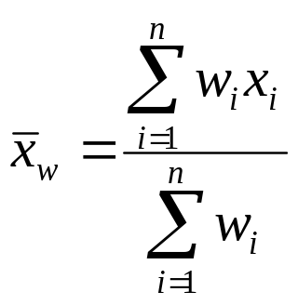
Weighted Mean
Certain events have unequal weights or unequal significance than the others. Grades for example would have different units credited, hence we have the general weighted average for which we have the formula:

Slide 16
Weighted Mean
In a barangay where there are 250 males and 300 females, If the females will spend on the 200 per day, while male will spend 150 per day, how much is the average spending of an individual on the barangay?
After one term, Jayson attained the following final grades on the following subjects, compute for his GPA.
SUBJECT | UNITS | FINAL GRADE
College Algebra | 5 | 2.75
Trigonometry | 3 | 2.00
Drawing | 2 | 2.00
English | 3 | 1.50
Chemistry | 4 | 2.25
Chemistry (Lab) | 1 | 1.50

Slide 17
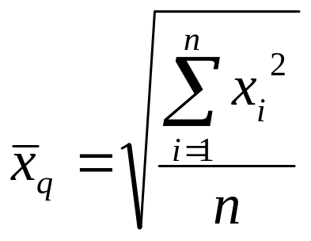
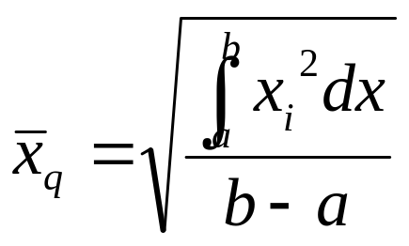
Quadratic Mean
Quadratic mean is sometimes called the root mean squared of a certain quantity. This is especially useful for certain quantities where the value of the quantity is continuously changing from positive and negative values such as the sinusoidal wave of the voltage. The formula for the quadratic mean is:

Slide 18
Quadratic Mean
Find the quadratic mean of the values:
1, 2, -1, 2, -1, 4, -1,3
Determine the Quadratic voltage of a signal that follows the following waveforms:
V = 10 sin t
V = t 0 < t <1

Slide 19
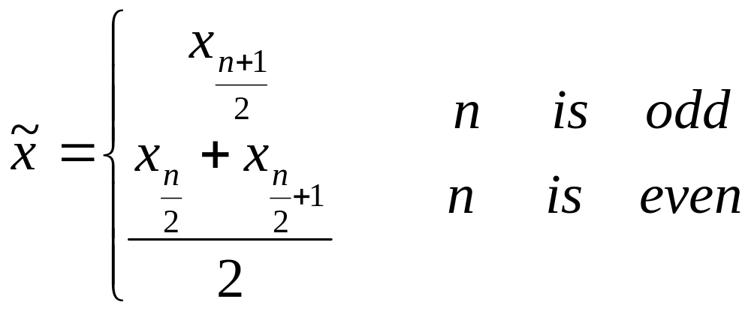

Median
Median is the value that divides the distribution into two equal parts or simply the middle value of the distribution.
Example:
Find the median of
1.8, 2.1, 1.7, 1.6, 0.9, 2.7, and 1.8
arranging the data from highest to lowest the middle element is :
2.7, 2.1, 1.8, 1.8, 1.7, 1.6, 0.9

Slide 20

Mode
Mode is the most frequent data in the distribution.
This is the only measure of central location that can be used for nominal data. It is the usually used in polls. If a distribution is said to have 2 modes, it is bi-modal, if three, a tri-modal.
Example:
At a certain polls, the following data were recorded: 1- Yes, 2 – No, 0 –Undecided. What is the modal choice?
1, 1, 1, 1, 1, 1, 1, 1, 1, 1, 1, 1, 0, 0, 0, 0, 2, 2, 2, 2, 2.

Slide 21
Measures of Position
Quartile
  Dividing the data set into 4 groups.
Decile
  Dividing the data set into 10 groups.
Percentile
  Dividing the data set into 100 groups.

Slide 22
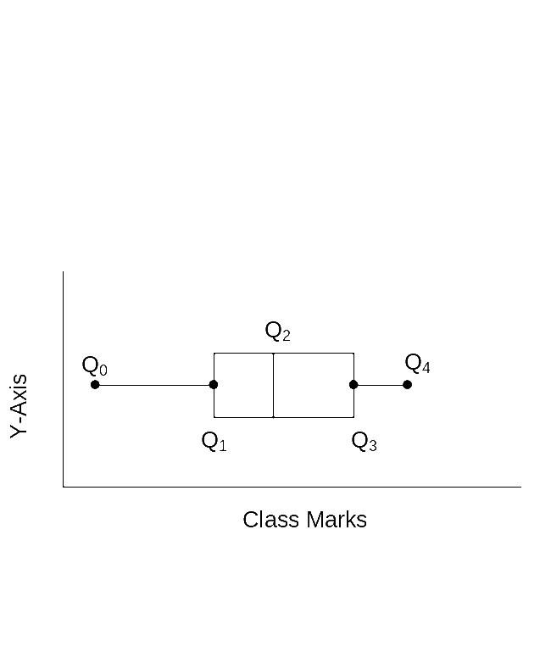
Quartile
is any of the three fractiles obtained by dividing the set of data into four equal parts.
  Q₁ is the lower quartile which contains the lowest 25% of the data.
  Q₂ is the median which divides the data into two equal parts.
  Q₃ is the third quartile which contains the upper 25% of the data.

Slide 23
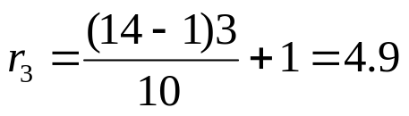
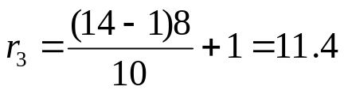




Decile and Percentile
Decile
  Dividing the data into 10 decile classes
Example:
Find the 3rd Decile and 8th Decile in the data set:
1.5, 3.5, 5.7, 6.0, 6.4, 6.6, 6.9, 7.0, 7.5, 7.7, 7.7, 7.9, 7.9, 8.0
In the 14 data, we can find the lower position of the 3rd and 8th deciles as:
Hence the value that we will be considering is the 4th and 11th data, with excess 0.9 and 0.4, respectively;
.

Slide 24
Measures of Variation
Range
  Range is the difference between the largest and smallest number in the set.
Mean Absolute Deviation
  Mean absolute deviation is the average of unsigned deviations from mean
Variance
  Variance is the average of square deviations
Standard Deviation
  The population standard deviation is given as the square root of variance
Coefficient of Variation
  The coefficient of variation is the percentage of the ratio of standard deviation to the mean.

Slide 25
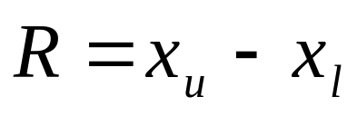
Range
Range is the difference between the largest and smallest number in the set.
Example:
Determine the range of:
1.8, 2.1, 1.7, 1.6, 0.9, 2.7, and 1.8

Slide 26
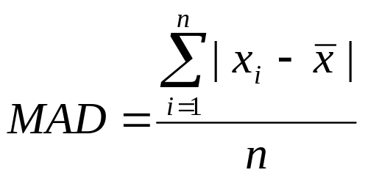
Mean Absolute Deviation
Mean absolute deviation is the average of unsigned deviations from mean
Example:
Determine the range of:
1.8, 2.1, 1.7, 1.6, 0.9, 2.7, and 1.8

Slide 27
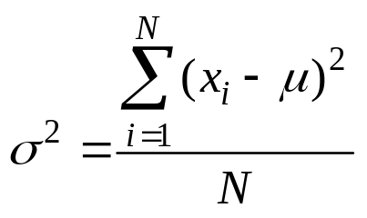
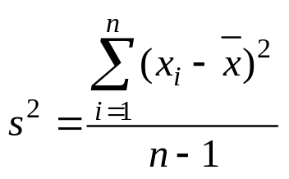
Variance
Variance is the average of square deviations
population sample
Example:
Determine the sample and population variances of:
1.8, 2.1, 1.7, 1.6, 0.9, 2.7, and 1.8

Slide 28
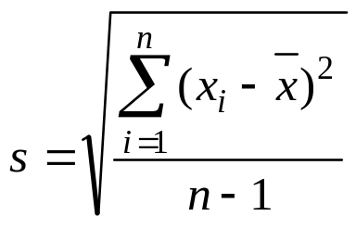
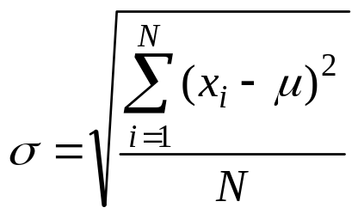
Standard Deviation
Standard deviation is given as the square root of variance
Population Sample
Example:
Determine the standard deviation of:
1.8, 2.1, 1.7, 1.6, 0.9, 2.7, and 1.8

Slide 29
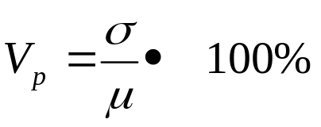
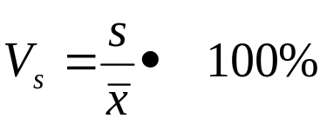
Coefficient of Variation
  The coefficient of variation is the percentage of the ratio of standard deviation to the mean.
Population Sample
Example:
Determine the coefficient of variation of:
1.8, 2.1, 1.7, 1.6, 0.9, 2.7, and 1.8

Slide 30
Measure of Shape
Skewness
Skewness is defined as the degree of asymmetry of distribution about a mean. It is a measure on how the data departs from being symmetrical. Based on the computed values of skewness, with a certain degree of tolerance, the data distribution can be interpreted as symmetric, positively skewed or negatively skewed.
Kurtosis
Kurtosis is the degree of peakedness exhibited by the distribution. It is computed as the fourth degree moment from the mean

Slide 31
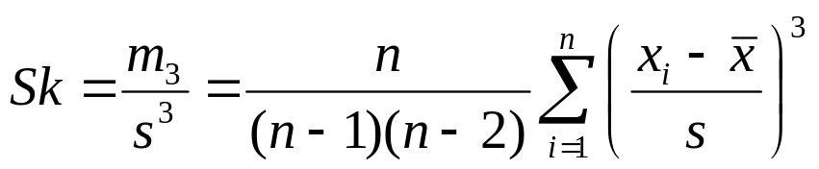
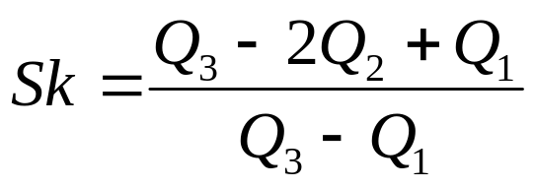
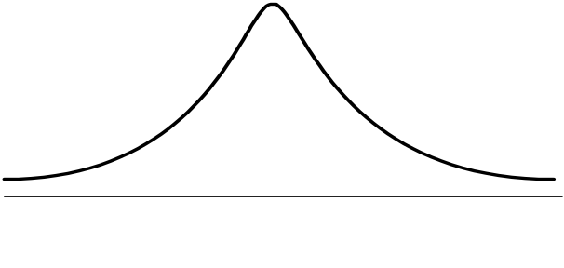
Skewness
degree of asymmetry of distribution about a mean
Moment Based Coefficient of Skewness
Bowley’s Coefficient of Skewness

Slide 32
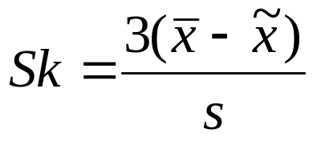
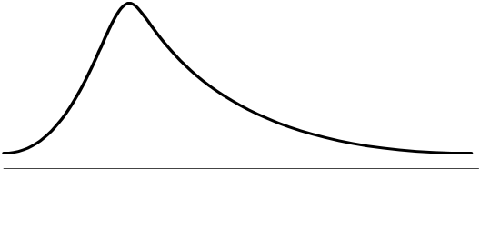
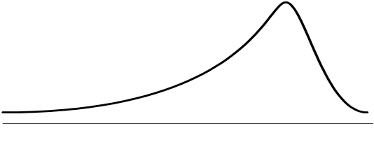
Skewness
Pearsonian Coefficient of Skewness
Symmetric Distribution
Sk =0 or -1 < Sk <1
Skewed to the right
Sk > 1
Skewed to the left
Sk <-1

Slide 33
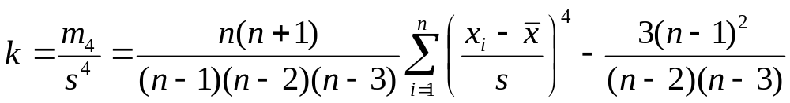
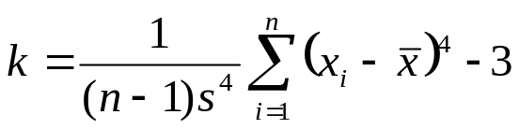
Kurtosis
the degree of peakedness exhibited by the distribution
Moment Based Coefficient of Kurtosis
Kurtosis
leptokurtic mesokurtic platykurtic

Slide 34
References
http://irving.vassar.edu/faculty/wl/econ209/dessript.pdf
http://www.preciousheart.net/chaplaincy/Auditor_Manual/10descsd.pdf

